Slide 1
Introduction to Data Structure

Slide 2
Basic Terminologies
Data Structure
  Data: are simply a value or set of values of differet type which is called data type like string, integer, chart etc.
  Structure: Way of organising information, so that it is easier to use.

Slide 3
Basic Terminologies
Data Structure :
        A data structure is a particular way of organizing data in a computer so that it can be used efficiently.
        A data structure is a logical model of a particular organization of data.

Slide 4
Why Data Structure
Human requirement with computer are going to complex day by day. To solve the complex requirements in efficient way we need this study.
Provides fastest solution of human requirements.
Provide efficient solution of complex problem.
          Space
          Time

Slide 5
Study in Data Structure
Logical or mathematical description of the structure.
Implementation of structure .
Quantitative analysis of the structure. this analysis includes determining the amount of memory needed to store the structure and the time required processing it.

Slide 6
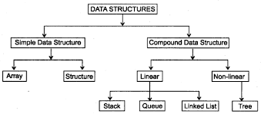
Classification of Data Structure

Slide 7
Classification of Data Structure
Simple Data Structure: Simple data structure can be constructed with the help of primitive data structure. A primitive data structure used to represent the standard data type of anyone of the computer languages( integer, character, float, etc.)
Compound Data Structure: Compound data structure can be constructed with the help of any one of the primitive data structure and it is having a specific functionality. It can be designed by user. It can be classified as linear and non – linear data structure.

Slide 8
Classification of Data Structure
Linear Data Structure: A Linear Data Structure traverses the data element sequentially, in which only one data element can directly be reached. Ex: Array, Linked Lists.
Non-Linear Data Structure: Every data item is attached to several other data items in a way that is specific for reflecting relationships. The data items are not arranged in a sequential structure. Ex: Trees, Graphs.

Slide 9
Operation on Linear / Non-Linear Data Structure
Add an element
Delete an element
Traverse / Display
Sort the list of elements
Search for a data element

Slide 10
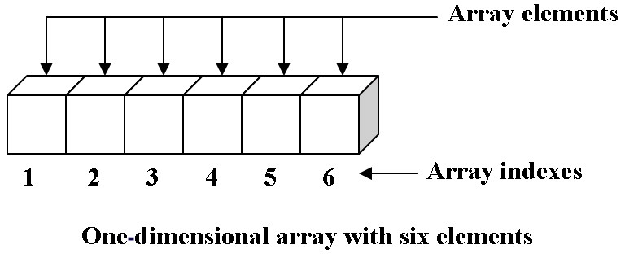
Type of Data Structure
Array : an array is a list of finite number of elements of same data type,i.e..,integers,reals,or strings etc

Slide 11
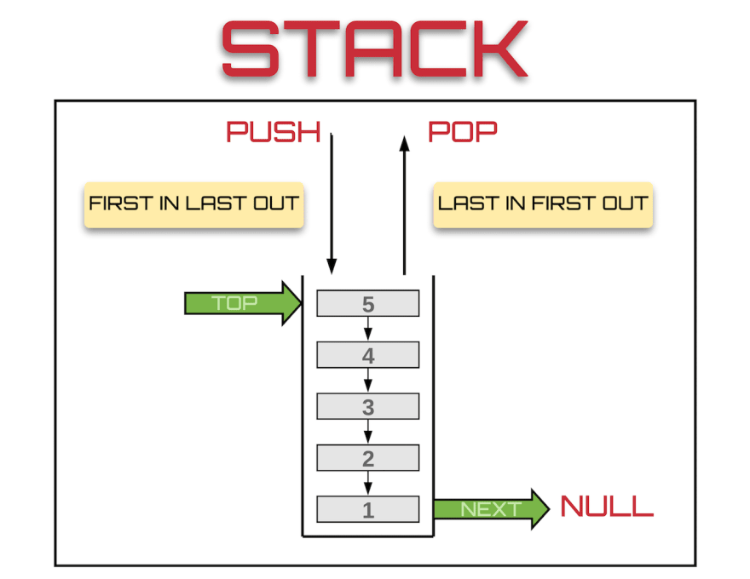
Type of Data Structure
Stack : a stack is a data structure in which items can be inserted only from one end and get items back from the same end. There, the last item inserted in to stack, is the first item is to be taken out from the stack. In short it also called Last in First Out (LIFO).

Slide 12
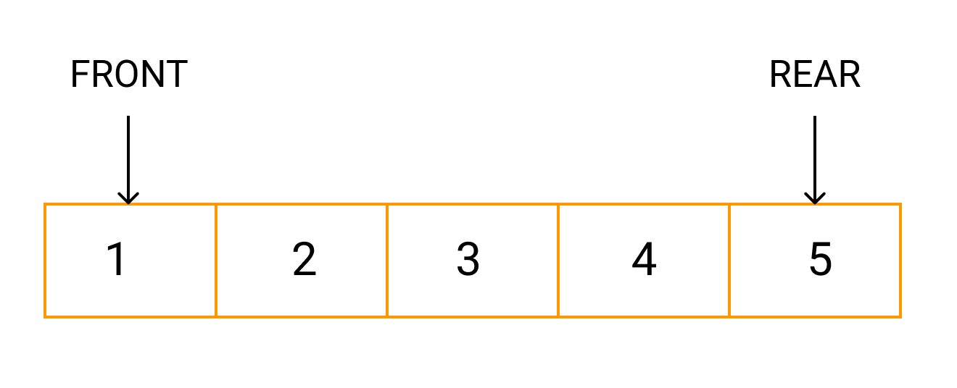
Type of Data Structure
Queue : A Queue is two ended data structure in which items can be inserted from one end and taken out from the other end. Therefore , the first item inserted in to queue is the first item is to be taken out from the queue. This property is called First in First Out (FIFO).

Slide 13
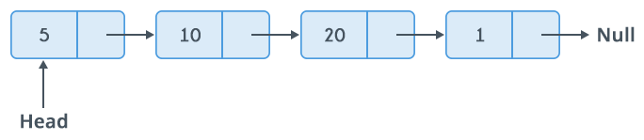
Type of Data Structure
Linked List : linked list is a linear collection of data element called nodes.the linear order is maintained by pointer.each nodes is divided into two or more parts.A linked list can be linear linked list(one-way list) or doubly linked list(two-way list).

Slide 14
Type of data structure
Tree : a tree is a data structure that representation a hierarchical relationship between various elements. A binary tree is a tree that can have utmost two children.
Either T is empty,called the null or empty tree, or
T contains a distinguished node R,called root of T,and remaining nodes from an orderd pairs of binary tree T1 and T2.

Slide 15
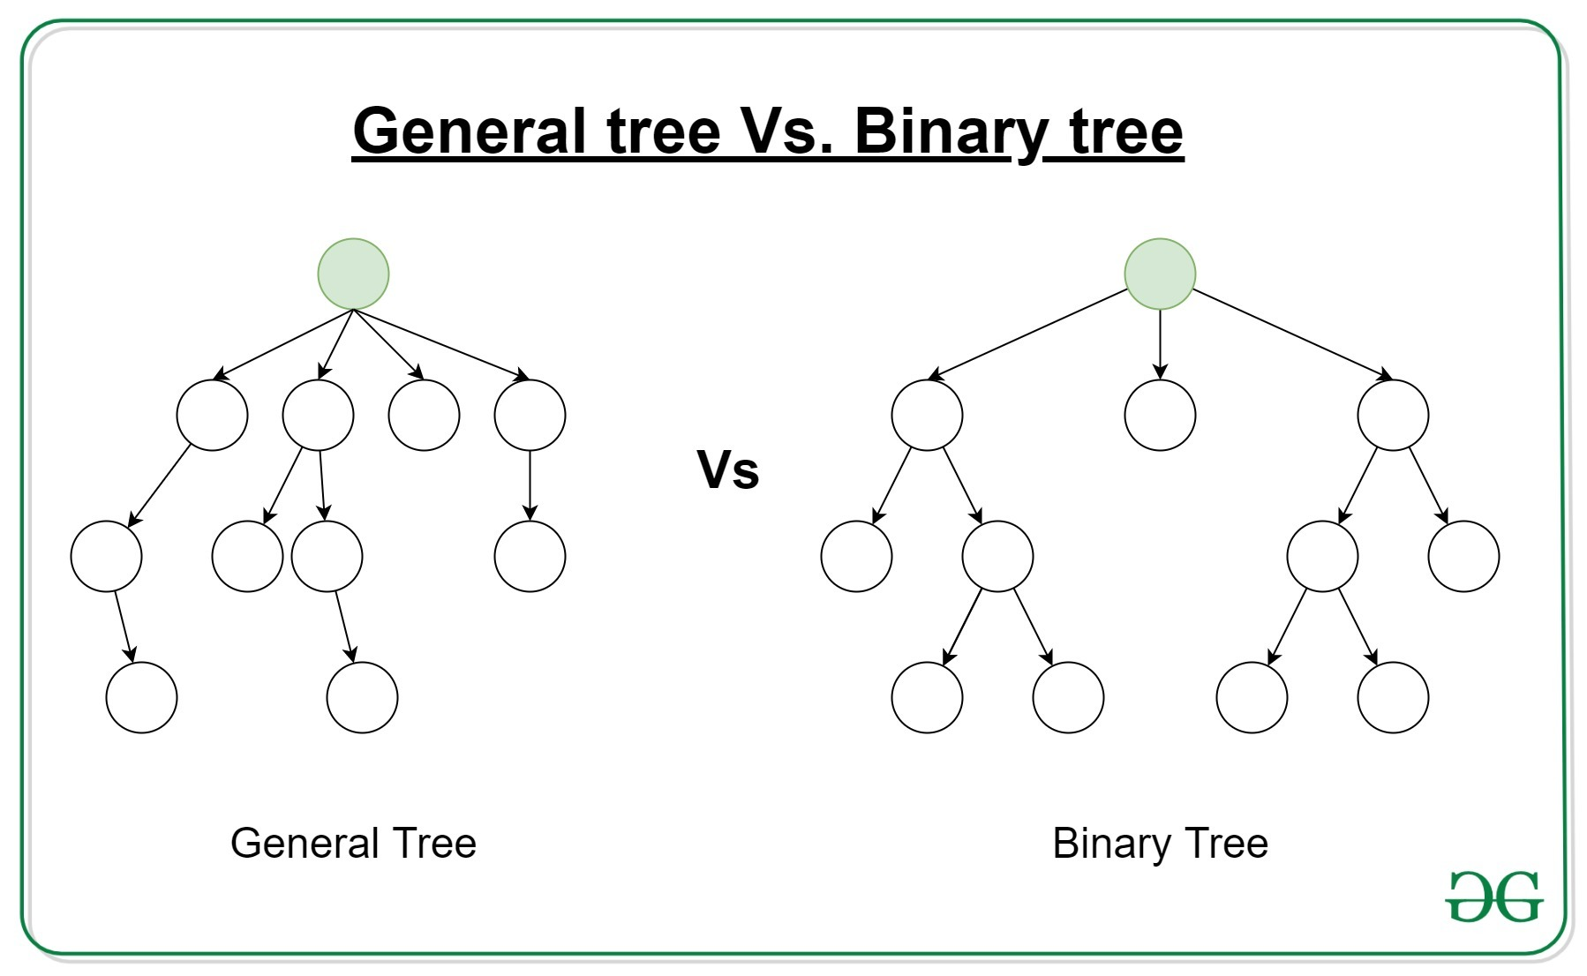

Slide 16
Type of Data Structure
Graph : It is a set of items connected by edges. Each item is called a vertex or node. Trees are just like a special kinds of graphs. Graphs are usually represented by G = (V,E), where V is the set vertices and E is the set of edges.

Slide 17
Type of Data Structure
Directed Graph : In directed graph a directional edge connect two node / vertex. If there is one edge from one vertex to other then only this path can be followed.

Slide 18
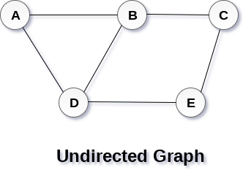
Type of Data Structure
Undirected Graph : A graph whose edges are unordered pair of vertices. That is each edge connects two vertices. In an undirected graph, direction is not important, if the path is available, it can be traversed in any direction.

Slide 19
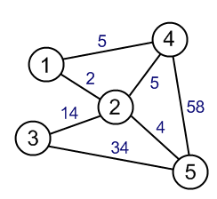
Type of Data Structure
Weighted Graph: a graph having a weight or number associated with each edge.

Slide 20
Selecting a Data Structure
Analyze the problem to determine the resource constraints a solution must meet.
Determine the basic operations that must be supported. Quantify the resource constraints for each operation.
Select the data structure that best meet these requirements.

